Slide 1

Interpretable, fair and cost-sensitive rulesets for data classification bachelor project defense ~Giuliano Cavallo
Interpretable, fair and cost-sensitive rulesets for data classification
Department of Mathematics and Computer Science
Notes:
Good morning everyone, thank you for coming.
My name is Giuliano Cavallo and today I will be defending my bachelor final project,
on Interpretable, fair and cost-sensitive rule sets for data classification

Slide 2
TOC
Introduction
Building an Interpretable Model
Cost sensitivity
Fairness
Class generalization
Conclusion
Department of Mathematics and Computer Science
Notes:
We begin with introduction, explaining goal
Then go through how each aspect of the model was formulated,
from interpretability to cost-sensitivity and fairness.
Finally, how this model can be generalized for further use cases
Conclude with a summary of what achieved and further steps

Slide 3
introduction: The problem

Slide 4


The Sample Classification Problem
Important decisions are made everyday that can impact a person’s life:
Businesses want to know which of their applicants will turn out to be good employees
Banks want to know which borrowers will return a loan in time
Doctors want to know which patients should be diagnosed with an Invisible Disease (ID)
Department of Mathematics and Computer Science
Notes:
Important decisions are made everyday, for instance:
Bussinesses - select good employees
Banks - who to lend money to
Doctors - which patients should diagnose

Slide 5
The Sample Classification Problem
Invisible diseases are those conditions that are not outwardly visible even to professionals and show minimal or no clinical symptoms.
They tend to go undiagnosed until the damage has progressed far.
Examples include acute kidney injury, clinically stable heart failure and some types of cancer.
However, they do correlate with other symptoms that we can test for
Department of Mathematics and Computer Science
Notes:
invisible disease cannot be tested for.
Big concern for professionals since
go undiagnosed until damage has progressed too far,
such as *examples*
invisible =!= undetectable,
They correlate with symptoms we CAN test
Has inspired the use of ML techniques for the purposes of diagnosis

Slide 6
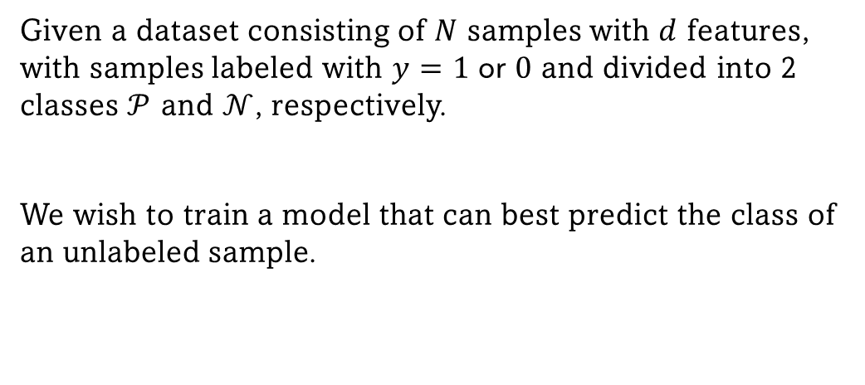
The Sample Classification Problem
Given a dataset consisting of $N$ samples with $d$ features, with samples labeled with $y=1$or$0$and divided into 2 classes $𝒫$ and $𝒩$, respectively.
We wish to train a model that can best predict the class of an unlabeled sample.
Patient Nr | Age | Cholesterol | Max heart rate | … | label
1 | 63 | 233 | 150 | … | 0
...
Department of Mathematics and Computer Science
Notes:
task becomes sample classification problem
We have a dataset … samples and features,
each sample labeled into 2 classes
We want to predict…
In our case, each sample represents…

Slide 7
Interpretability
We must be able to investigate the model if we wish to use it for high-stakes applications.
No black box methods: The model must output the decisions chosen to classify the samples. We will choose a rule base method.
This allows us to identify explicit biases and provides some basis on which to trust these results.
If Male AND … Then good employee
Department of Mathematics and Computer Science
Notes:
many types of ML,
not all suitable for high stakes
avoid BLACK BOX models, like Neural Networks,
only give prediction , not reasoning
If we ‘open them up’..
cannot trust if cannot be questioned
Consider the following situation,
we train a model with … a model might determine that sex is a good indicator for being a good employee, since we most employees are male.
We will choose a rule-based approach for this problem

Slide 8
Interpretability
Rule set must be in Disjunctive Normal Form (DNF)
A Rule Set is a combination of unordered rules (by disjunction / OR operators),
If <Rule 1> Then <Positive Diagnosis>
OR
If <Rule 2> Then <Positive Diagnosis>
OR
If <Rule 3> Then <Positive Diagnosis>
….
If <Rule 1> Then <Positive Diagnosis>
Else If <Rule 2> Then <Positive Diagnosis>
Else If <Rule 3> Then <Positive Diagnosis>
….
Department of Mathematics and Computer Science
Notes:
Rules not enough,
we need interpretable
For a rule set to be interpretable, it needs to satisfy 2 additional conditions
The first states that a rule set must be in DNF,
This means that a r.set is a combination on unordered rules by disjunction
On the left… On this right…

Slide 9
Interpretability
Rules must be in Disjunctive Normal Form (DNF)
A Rule Set is a combination of unordered rules (by disjunction / OR operators),
Each rule is a combination of literals (by conjunction / AND operators),
<Rule 1> := (A) AND (B) AND (C)
If <Rule 1> Then <Positive Diagnosis>
OR
If <Rule 2> Then <Positive Diagnosis>
OR
If <Rule 3> Then <Positive Diagnosis>
….
Department of Mathematics and Computer Science
Notes:
Each rule is a conjunction of conditions

Slide 10
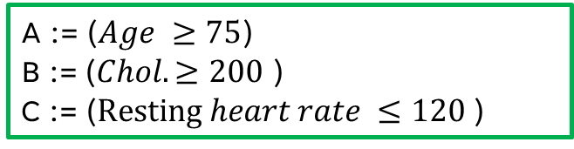
Interpretability
Rules must be in Disjunctive Normal Form (DNF)
A Rule Set is a combination of unordered rules (by disjunction / OR operators),
Each rule is a combination of literals (by conjunction / AND operators),
Each literal is an inequality involving a single feature.
A := ($Age ≥75$)
B := ($Chol. ≥200$ )
C := ($Resting heart rate ≤120$)
A := ($3 Age + 7 Chol. –Resting heart rate ≤ 10.3$)
Department of Mathematics and Computer Science
Notes:
Each condition is an inequality involving a single feature.
On the left (by a SVM). Its hard to know
who is this applying to. Does it apply to me?
On the right its clear.

Slide 11
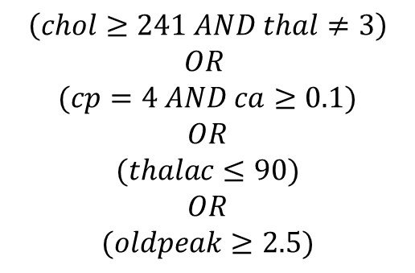
Interpretability
Rules must be in Disjunctive Normal Form (DNF)
A Rule Set is a combination of unordered rules (by disjunction / OR operators),
Each rule is a combination of literals (by conjunction / AND operators),
Each literal is an inequality involving a single feature.
$$\left(chol≥241 AND thal≠3\right)$$
$$OR$$
$$(cp=4 AND ca≥0.1)$$
$$OR$$
$$(thalac≤90)$$
$$OR$$
$$(oldpeak≥2.5)$$
(Then, y=1)
Department of Mathematics and Computer Science
Notes:
example of DNF rule set

Slide 12
Interpretability
Rules must be in Disjunctive Normal Form (DNF)
Department of Mathematics and Computer Science
Notes:
And in addition to DNF, it also need to ->

Slide 13
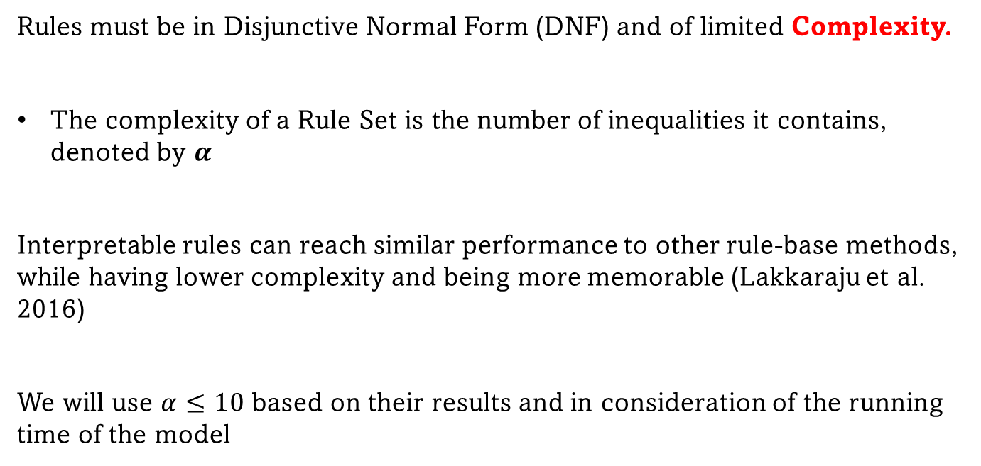
Interpretability
Rules must be in Disjunctive Normal Form (DNF) and of limited Complexity.
The complexity of a Rule Set is the number of inequalities it contains, denoted by $α$
Interpretable rules can reach similar performance to other rule-base methods, while having lower complexity and being more memorable (Lakkaraju et al. 2016)
We will use $α≤10$ based on their results and in consideration of the running time of the model
H. Lakkaraju et al. Interpretable decision sets: A joint framework for description and prediction. In Proceedings of the 22nd ACM SIGKDD International Conference on Knowledge Discovery and Data Mining, 2016. Association for Computing Machinery.
Department of Mathematics and Computer Science
Notes:
Have a limited complexity.
By complexity, we mean…
The reason we want interpretable is … more memorable and less complex
Based on their results and running time,, complexity <= 10

Slide 14
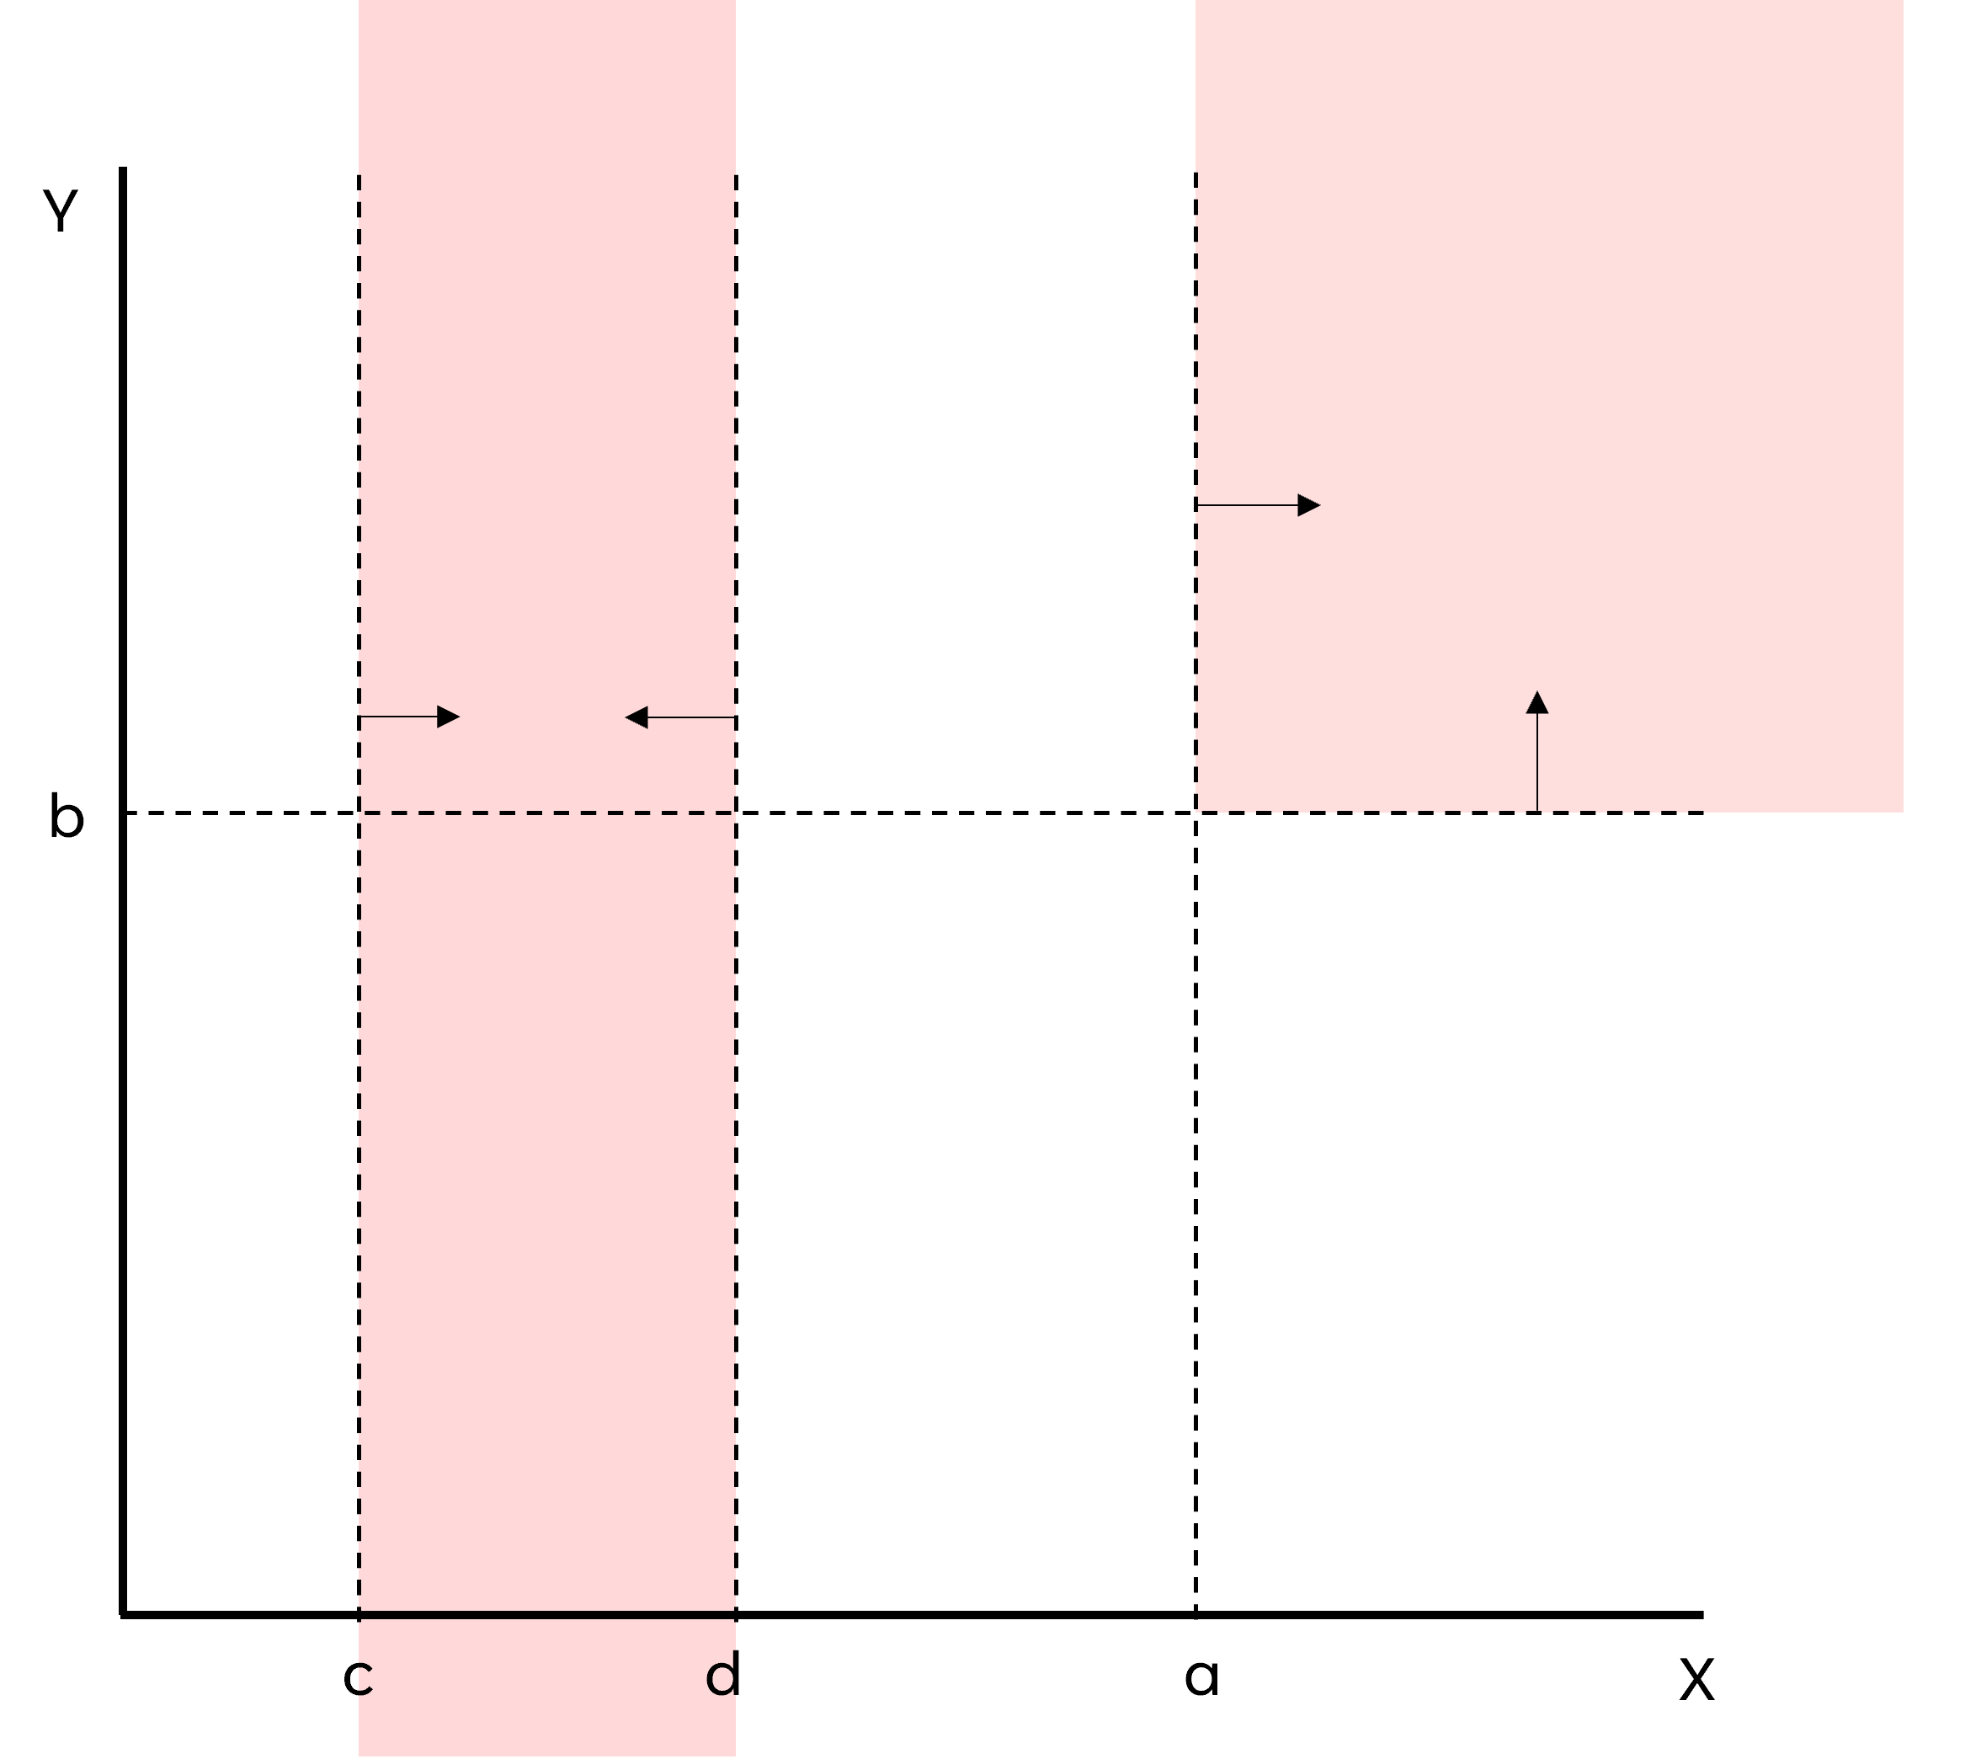
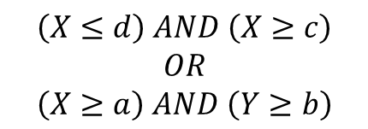
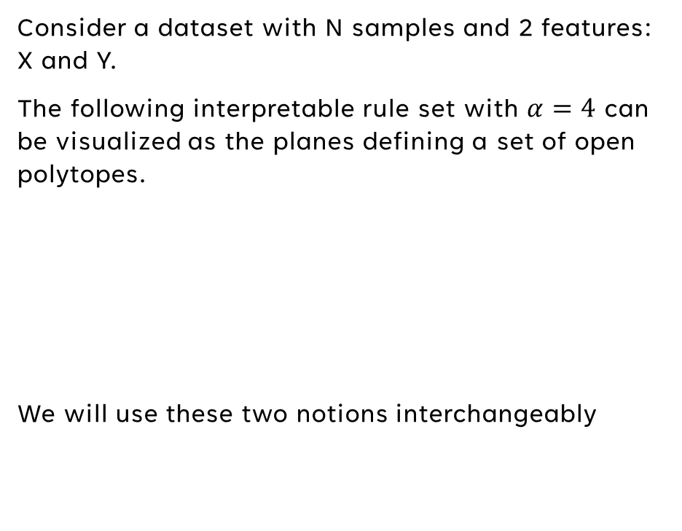
Rectangle configuration equivalence
Consider a dataset with N samples and 2 features: X and Y.
The following interpretable rule set with $α=4$ can be visualized as the planes defining a set of open polytopes.
We will use these two notions interchangeably
$$\left(X≤d\right) AND \left(X≥c\right)$$
$$OR$$
$$\left(X≥a\right) AND \left(Y≥b\right)$$
Department of Mathematics and Computer Science
Notes:
Useful to realize: Finding a DNF r.set is equivalent to finding rectangles

Slide 15
building an interpretable model

Slide 16
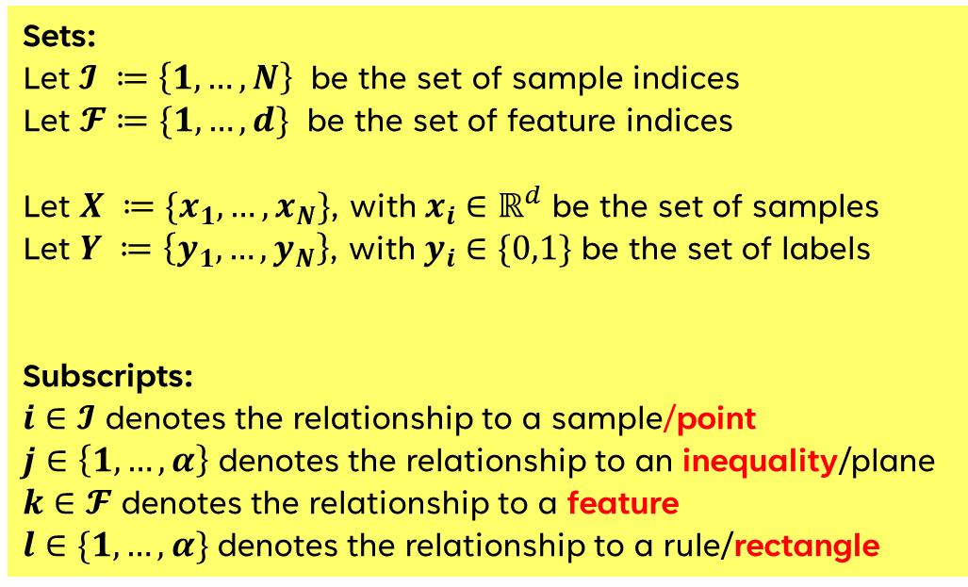
Notation Conventions
Sets:
Let $𝓘 ≔\left\{1, …, N\right\}$ be the set of sample indices
Let $𝓕≔\{1,…,d\}$ be the set of feature indices
Let $X ≔\{x_{1},…,x_{N}\}$, with $x_{i}∈ℝ^{d}$ be the set of samples
Let $Y ≔\left\{y_{1},…,y_{N}\right\}$, with $y_{i}∈\{0,1\}$ be the set of labels
Subscripts:
$i∈𝓘$ denotes the relationship to a sample/point
$j∈\left\{1,…,α\right\}$ denotes the relationship to an inequality/plane
$k∈𝓕$ denotes the relationship to a feature
$l∈\{1,…,α\}$ denotes the relationship to a rule/rectangle
Department of Mathematics and Computer Science
Notes:
*Note l and j go from 1 to alpha*

Slide 17

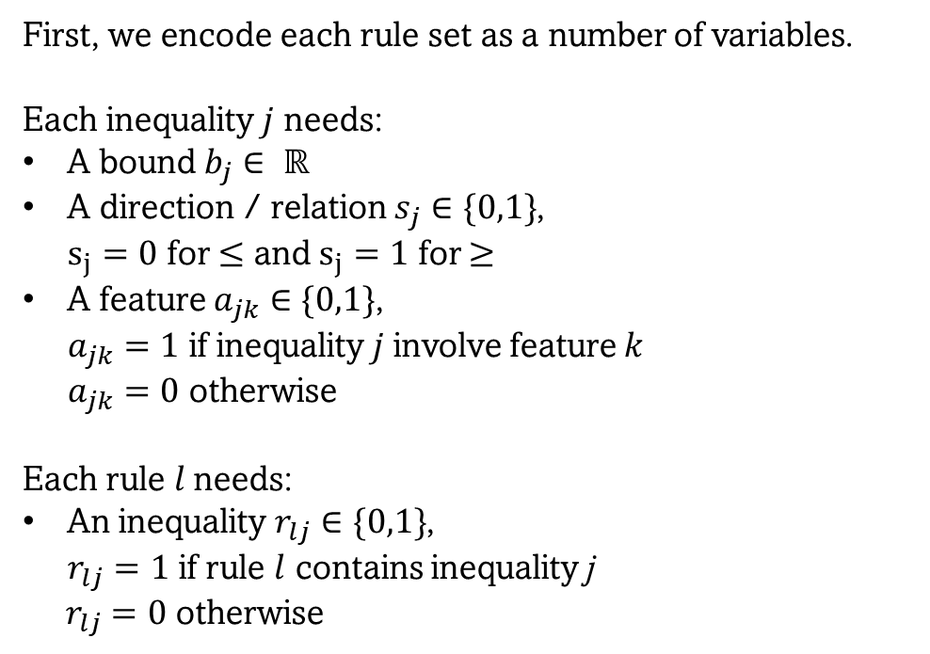
Encoding a rule set
First, we encode each rule set as a number of variables.
Each inequality $j$ needs:
A bound $b_{j}∈ ℝ$
A direction / relation $s_{j}∈\{0,1\}$,
$s_{j}=0$ for $≤$ and $s_{j}=1$ for $≥$
A feature $a_{jk}∈\{0,1\}$,
$a_{jk}=1$ if inequality$j$involve feature $k$
$a_{jk}=0$ otherwise
Each rule $l$needs:
An inequality $r_{lj}∈\{0,1\}$,
$r_{lj}=1$ if rule $l$ contains inequality j
$r_{lj}=0$ otherwise
j
$$\left( a_{j}⋅x_{i} ≤ b_{j} \right)$$
k
b
Department of Mathematics and Computer Science
Notes:
Encode a rule set.
An inequality needs:
A bound
A direction
A feature
*For DNF, a is a unit vector*
And we need to join these ineqs, which we denote with r

Slide 18
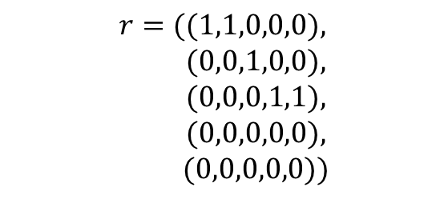
Encoding a rule set
First, we encode each rule set as a number of variables.
Each inequality $j$ needs:
A bound $b_{j}∈ ℝ$
A direction / relation $s_{j}∈\{0,1\}$,
$s_{j}=0$ for $≤$ and $s_{j}=1$ for $≥$
A feature $a_{jk}∈\{0,1\}$,
$a_{jk}=1$ if inequality$j$involve feature $k$
$a_{jk}=0$ otherwise
Each rule $l$needs:
An inequality $r_{lj}∈\{0,1\}$,
$r_{lj}=1$ if rule $l$ contains inequality j
$r_{lj}=0$ otherwise
$$r=((1,1,0,0,0),$$
$$(0,0,1,0,0),$$
$$(0,0,0,1,1),$$
$$(0,0,0,0,0),$$
$$(0,0,0,0,0))$$
Department of Mathematics and Computer Science
Notes:
r is essentially a matrix where columns are inequs and rows are rules.
To allow for the model to choose one inequ … there will be empty rectangles

Slide 19
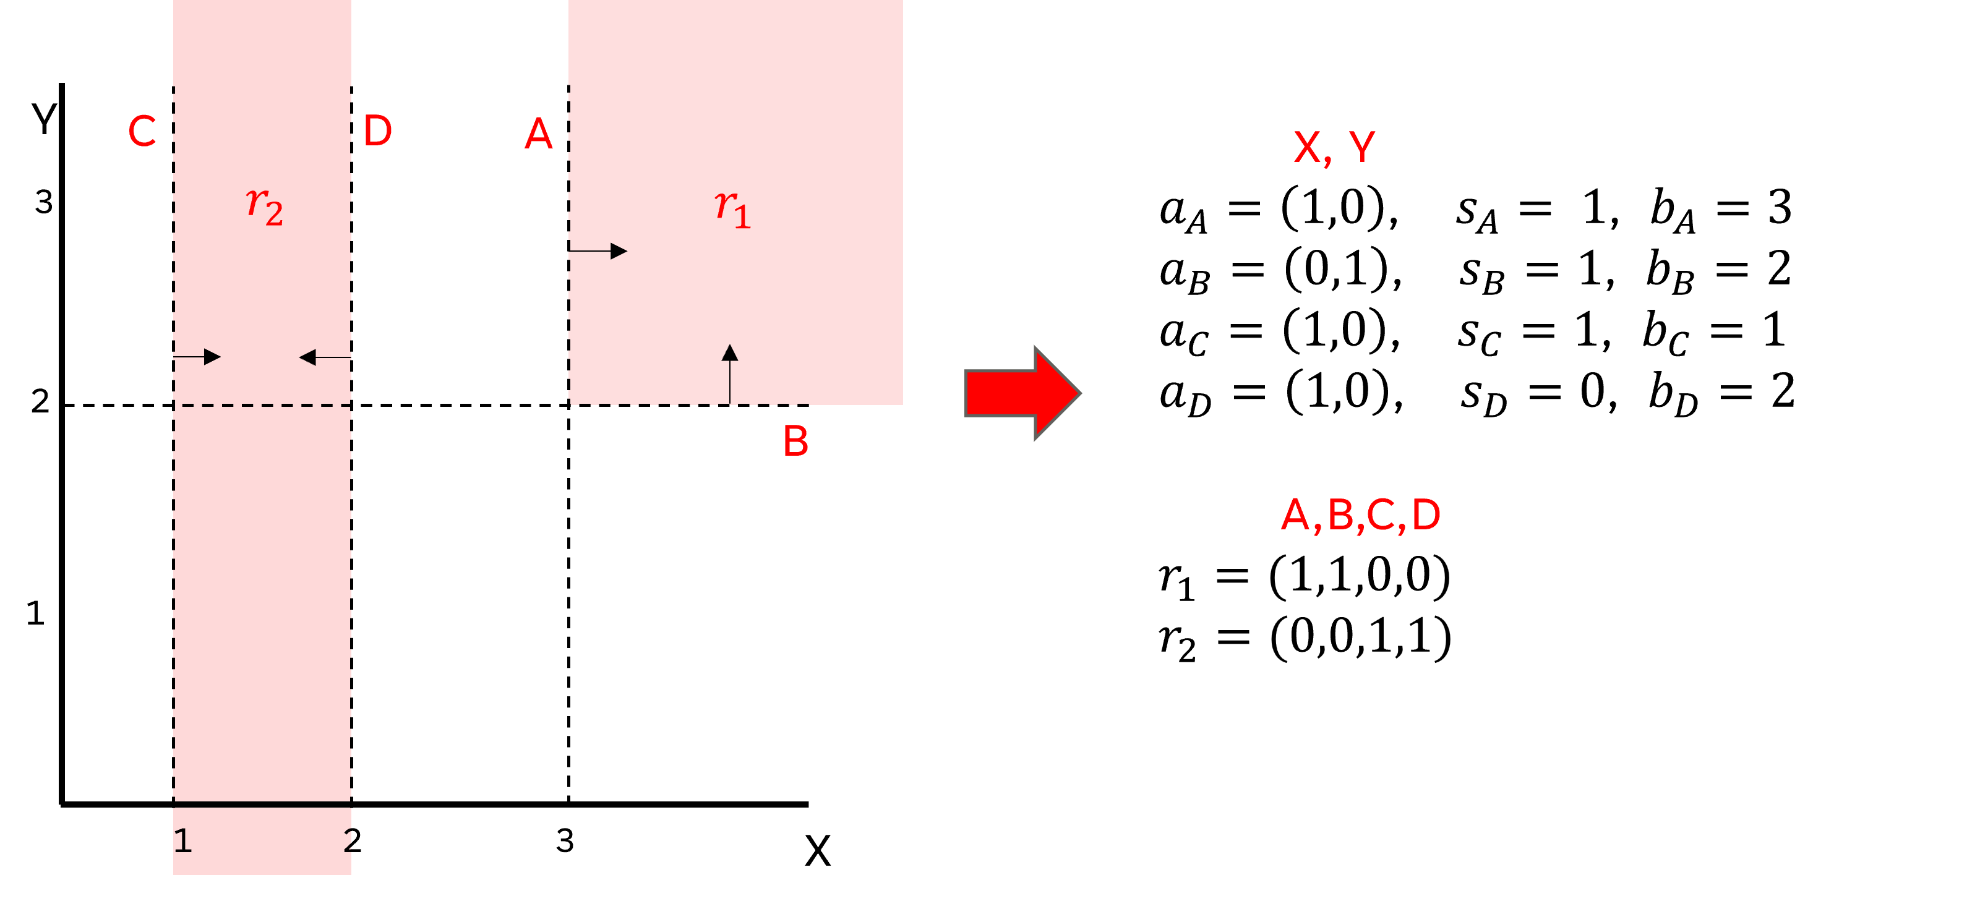
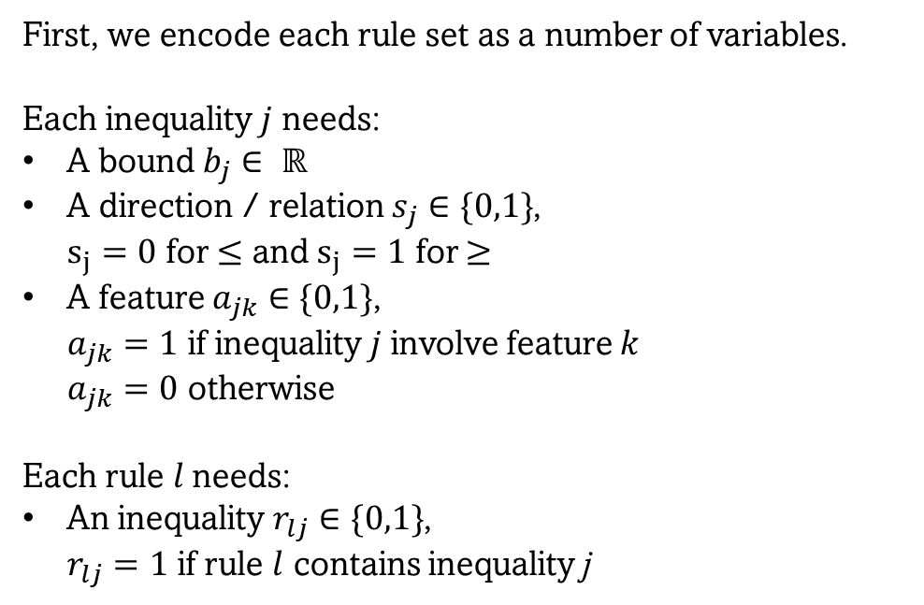
Encoding a rule set
First, we encode each rule set as a number of variables.
Each inequality $j$ needs:
A bound $b_{j}∈ ℝ$
A direction / relation $s_{j}∈\{0,1\}$,
$s_{j}=0$ for $≤$ and $s_{j}=1$ for $≥$
A feature $a_{jk}∈\{0,1\}$,
$a_{jk}=1$ if inequality$j$involve feature $k$
$a_{jk}=0$ otherwise
Each rule $l$needs:
An inequality $r_{lj}∈\{0,1\}$,
$r_{lj}=1$ if rule $l$ contains inequality j
Department of Mathematics and Computer Science
Notes:
Going back to the previous example, this is how such a rule set would be encoded.
With a slight abuse of notation with the indices for covenience

Slide 20
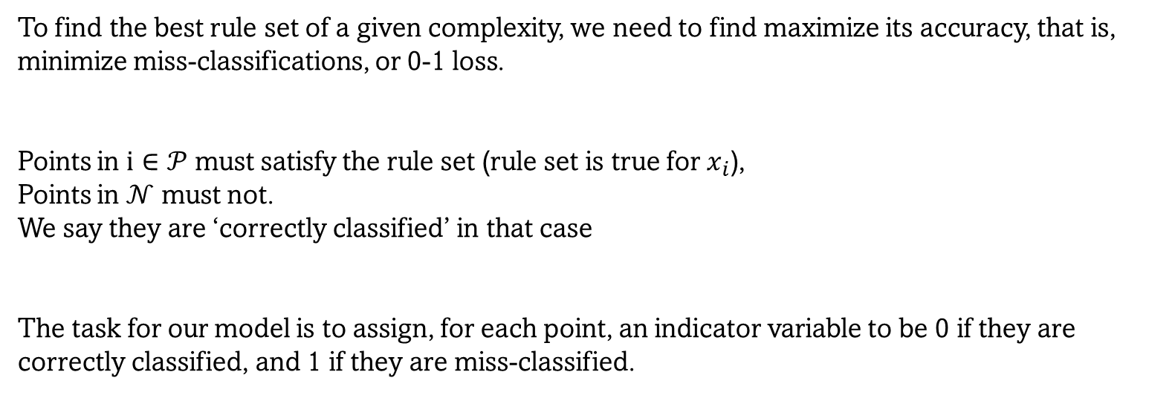
Encoding a rule set
To find the best rule set of a given complexity, we need to find maximize its accuracy, that is, minimize miss-classifications, or 0-1 loss.
Points in $i∈𝒫$ must satisfy the rule set (rule set is true for $x_{i}$),
Points in $𝒩$ must not.
We say they are ‘correctly classified’ in that case
The task for our model is to assign, for each point, an indicator variable to be 0 if they are correctly classified, and 1 if they are miss-classified.
Department of Mathematics and Computer Science
Notes:
To find the best rule set, we must know how accurate it is,
so we need to know how many points are miss-classified by a rule set
The task is to encode the behave, of indicator, 0=good. 1=bad
Add them and minimize

Slide 21
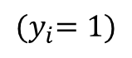
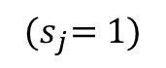
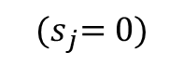
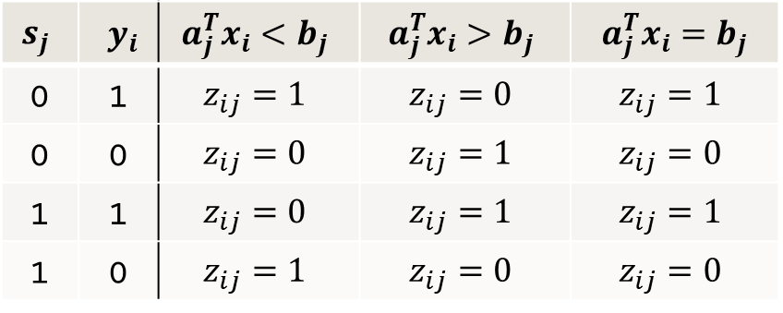
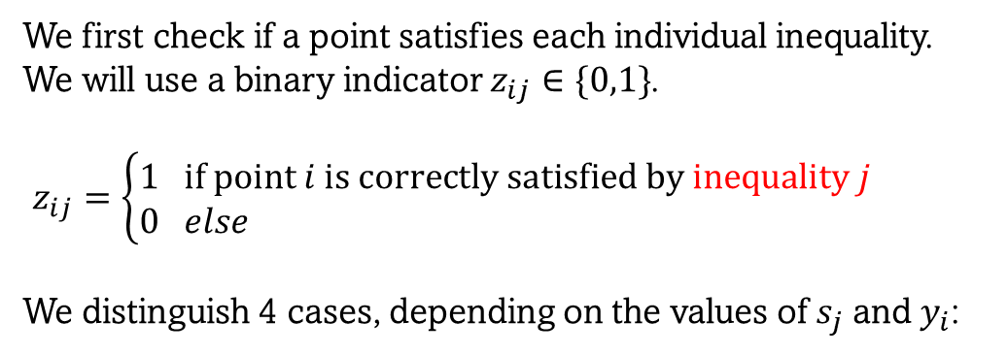
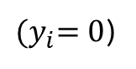
Encoding a rule set - Inequalities
We first check if a point satisfies each individual inequality.
We will use a binary indicator $z_{ij}∈\{0,1\}$.
$z_{ij}=\left\{\begin{aligned}1& if point i is correctly satisfied by inequality j \\ 0& else\end{aligned}\right.$
We distinguish 4 cases, depending on the values of $s_{j}$ and $y_{i}$:
$${(s}_{j}=0)$$
$${(s}_{j}=1)$$
$${(y}_{i}=1)$$
$$s_{j}$$ | $y_{i}$ | $$a_{j}^{T}x_{i}<b_{j}$$ | $$a_{j}^{T}x_{i}>b_{j}$$ | $a_{j}^{T}x_{i}=b_{j}$
0 | 1 | $$z_{ij}=1$$ | $$z_{ij}=0$$ | $$z_{ij}=1$$
0 | 0 | $$z_{ij}=0$$ | $$z_{ij}=1$$ | $$z_{ij}=0$$
1 | 1 | $$z_{ij}=0$$ | $$z_{ij}=1$$ | $$z_{ij}=1$$
1 | 0 | $$z_{ij}=1$$ | $$z_{ij}=0$$ | $$z_{ij}=0$$
${(y}_{i}=0$)
Department of Mathematics and Computer Science
Notes:
begin by determining whether a point is corrc.classi. by an inequality
track with z
Distinguish 4 cases, depending on s and y,

Slide 22
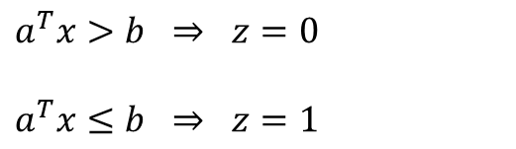
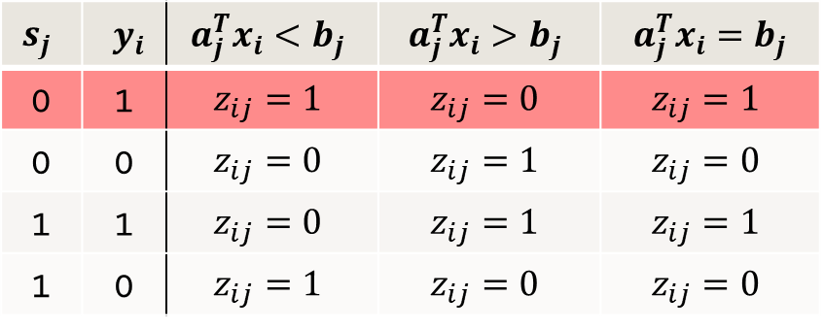
Encoding a rule set - Inequalities
We encode each case with 2 big-M constraints:
$$s_{j}$$ | $y_{i}$ | $$a_{j}^{T}x_{i}<b_{j}$$ | $$a_{j}^{T}x_{i}>b_{j}$$ | $a_{j}^{T}x_{i}=b_{j}$
0 | 1 | $$z_{ij}=1$$ | $$z_{ij}=0$$ | $$z_{ij}=1$$
0 | 0 | $$z_{ij}=0$$ | $$z_{ij}=1$$ | $$z_{ij}=0$$
1 | 1 | $$z_{ij}=0$$ | $$z_{ij}=1$$ | $$z_{ij}=1$$
1 | 0 | $$z_{ij}=1$$ | $$z_{ij}=0$$ | $$z_{ij}=0$$
$a^{T}x>b ⇒ z=0$
$a^{T}x≤b ⇒ z=1$
Department of Mathematics and Computer Science
Notes:
Consider this first condition, this is essentially 2 if-then statements *show*
Only one of these can be true at a time, so we need a way for the model choose only one depending on z

Slide 23
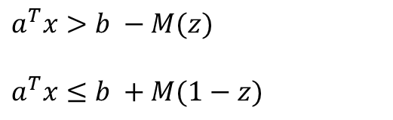
Encoding a rule set - Inequalities
We encode each case with 2 big-M constraints:
$$s_{j}$$ | $y_{i}$ | $$a_{j}^{T}x_{i}<b_{j}$$ | $$a_{j}^{T}x_{i}>b_{j}$$ | $a_{j}^{T}x_{i}=b_{j}$
0 | 1 | $$z_{ij}=1$$ | $$z_{ij}=0$$ | $$z_{ij}=1$$
0 | 0 | $$z_{ij}=0$$ | $$z_{ij}=1$$ | $$z_{ij}=0$$
1 | 1 | $$z_{ij}=0$$ | $$z_{ij}=1$$ | $$z_{ij}=1$$
1 | 0 | $$z_{ij}=1$$ | $$z_{ij}=0$$ | $$z_{ij}=0$$
$a^{T}x>b −M(z)$
$a^{T}x≤b +M(1−z)$
Department of Mathematics and Computer Science
Notes:
We do this by multiplying z with a very large number M, large enough to make the constraint redundant regardless of x and b.
Then, whenever <=b, lower z can be anything, but upper is false unless z=1
Now, such a constraint (>) is actually illegal ->

Slide 24
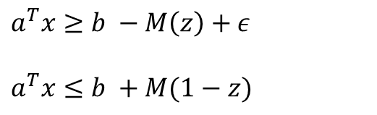
Encoding a rule set - Inequalities
We encode each case with 2 big-M constraints:
$$s_{j}$$ | $y_{i}$ | $$a_{j}^{T}x_{i}<b_{j}$$ | $$a_{j}^{T}x_{i}>b_{j}$$ | $a_{j}^{T}x_{i}=b_{j}$
0 | 1 | $$z_{ij}=1$$ | $$z_{ij}=0$$ | $$z_{ij}=1$$
0 | 0 | $$z_{ij}=0$$ | $$z_{ij}=1$$ | $$z_{ij}=0$$
1 | 1 | $$z_{ij}=0$$ | $$z_{ij}=1$$ | $$z_{ij}=1$$
1 | 0 | $$z_{ij}=1$$ | $$z_{ij}=0$$ | $$z_{ij}=0$$
$a^{T}x≥b −M\left(z\right)+ε$
$a^{T}x≤b +M(1−z)$
Department of Mathematics and Computer Science
Notes:
So we need to relax it by adding a small value epsilon.
As before, this only models the top statement.
We want this constraint to only be enforced when s=0 and y=1
Since y is a parameter, not a variable, we can just choose to only include the 2 appropriate constraints for each point
But that still leaves the matter of s ->

Slide 25
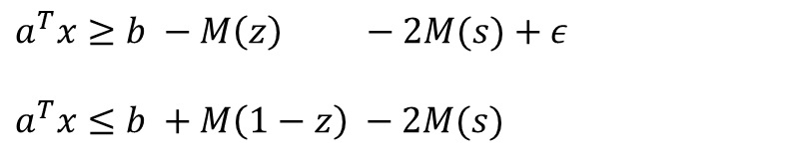
Encoding a rule set - Inequalities
We encode each case with 2 big-M constraints:
$$s_{j}$$ | $y_{i}$ | $$a_{j}^{T}x_{i}<b_{j}$$ | $$a_{j}^{T}x_{i}>b_{j}$$ | $a_{j}^{T}x_{i}=b_{j}$
0 | 1 | $$z_{ij}=1$$ | $$z_{ij}=0$$ | $$z_{ij}=1$$
0 | 0 | $$z_{ij}=0$$ | $$z_{ij}=1$$ | $$z_{ij}=0$$
1 | 1 | $$z_{ij}=0$$ | $$z_{ij}=1$$ | $$z_{ij}=1$$
1 | 0 | $$z_{ij}=1$$ | $$z_{ij}=0$$ | $$z_{ij}=0$$
$a^{T}x≥b −M\left(z\right) −2M(s)+ε$
$a^{T}x≤b +M\left(1−z\right) −2M(s)$
Department of Mathematics and Computer Science
Notes:
Which we can model by using a larger M.
Other constraints are modelled similarly, we will not go into them in depth just note their behavior needs to be encoded using linear inequalities

Slide 26
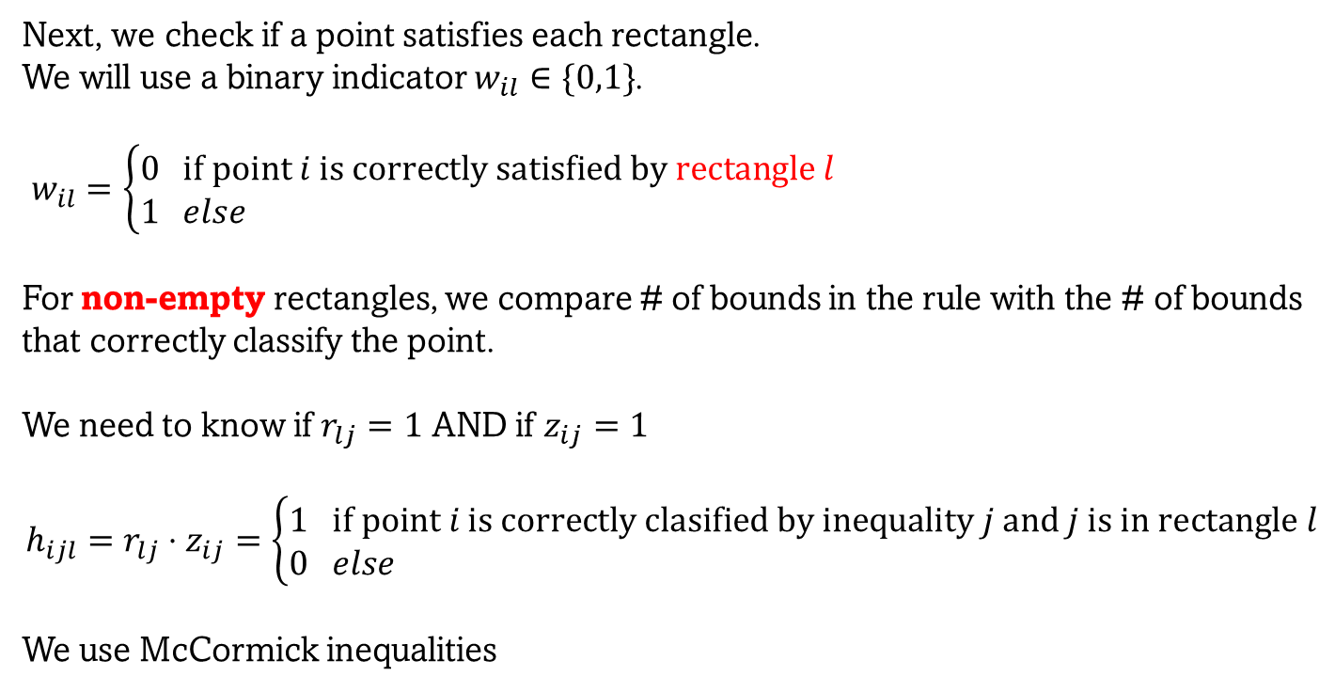
Encoding a rule set - Rectangles
Next, we check if a point satisfies each rectangle.
We will use a binary indicator $w_{il}∈\{0,1\}$.
$w_{il}=\left\{\begin{aligned}0& if point i is correctly satisfied by rectangle l \\ 1& else\end{aligned}\right.$
For non-empty rectangles, we compare # of bounds in the rule with the # of bounds that correctly classify the point.
We need to know if $r_{lj}=1$ AND if $z_{ij}=1$
$$h_{ijl}=r_{lj}⋅z_{ij}=\left\{\begin{aligned}1& if point i is correctly clasified by inequality j and j is in rectangle l \\ 0& else\end{aligned}\right.$$
We use McCormick inequalities
Department of Mathematics and Computer Science
Notes:
Next we need to know if a point is satisfied by a rectangle, which we will track with indicator w
For non-empty rectangles, we can check the number …
But to check this, we need to know whether j is in l AND whether j classifies I
Since r and z are binary indicators, an AND is just a product. To turn this into a set of linear inequalities, we need to encode them using McCormick inequalities
And we are forced to create a new indicator h

Slide 27
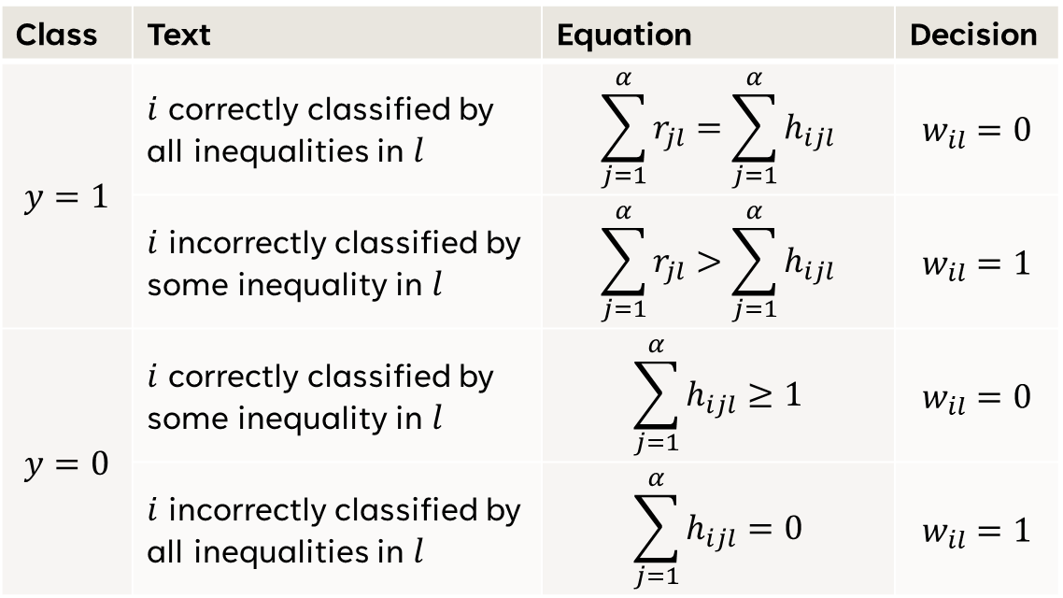
Encoding a rule set - Rectangles
Class | Text | Equation | Decision
$$y=1$$ | $i$ correctly classified by all inequalities in $l$ | $$\sum_{j=1}^{α}{r_{jl}}=\sum_{j=1}^{α}{h_{ijl}}$$ | $$w_{il}=0$$
 | $i$ incorrectly classified by some inequality in $l$ | $$\sum_{j=1}^{α}{r_{jl}}>\sum_{j=1}^{α}{h_{ijl}}$$ | $$w_{il}=1$$
$$y=0$$ | $i$ correctly classified by some inequality in $l$ | $$\sum_{j=1}^{α}{h_{ijl}}≥1$$ | $$w_{il}=0$$
 | $i$ incorrectly classified by all inequalities in $l$ | $$\sum_{j=1}^{α}{h_{ijl}}=0$$ | $$w_{il}=1$$
Department of Mathematics and Computer Science
Notes:
We encode w as follows
*explain*

Slide 28
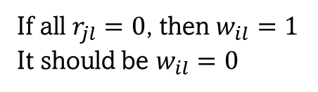
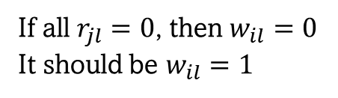
Encoding a rule set - Rectangles
Class | Text | Equation | Decision
$$y=1$$ | $i$ correctly classified by all inequalities in $l$ | $$\sum_{j=1}^{α}{r_{jl}}=\sum_{j=1}^{α}{h_{ijl}}$$ | $$w_{il}=0$$
 | $i$ incorrectly classified by some inequality in $l$ | $$\sum_{j=1}^{α}{r_{jl}}>\sum_{j=1}^{α}{h_{ijl}}$$ | $$w_{il}=1$$
$$y=0$$ | $i$ correctly classified by some inequality in $l$ | $$\sum_{j=1}^{α}{h_{ijl}}≥1$$ | $$w_{il}=0$$
 | $i$ incorrectly classified by all inequalities in $l$ | $$\sum_{j=1}^{α}{h_{ijl}}=0$$ | $$w_{il}=1$$
If all $r_{jl}=0$, then $w_{il}=0$
It should be $w_{il}=1$
If all $r_{jl}=0$, then $w_{il}=1$
It should be $w_{il}=0$
Department of Mathematics and Computer Science
Notes:
Now, notice that for empty rectangles …

Slide 29
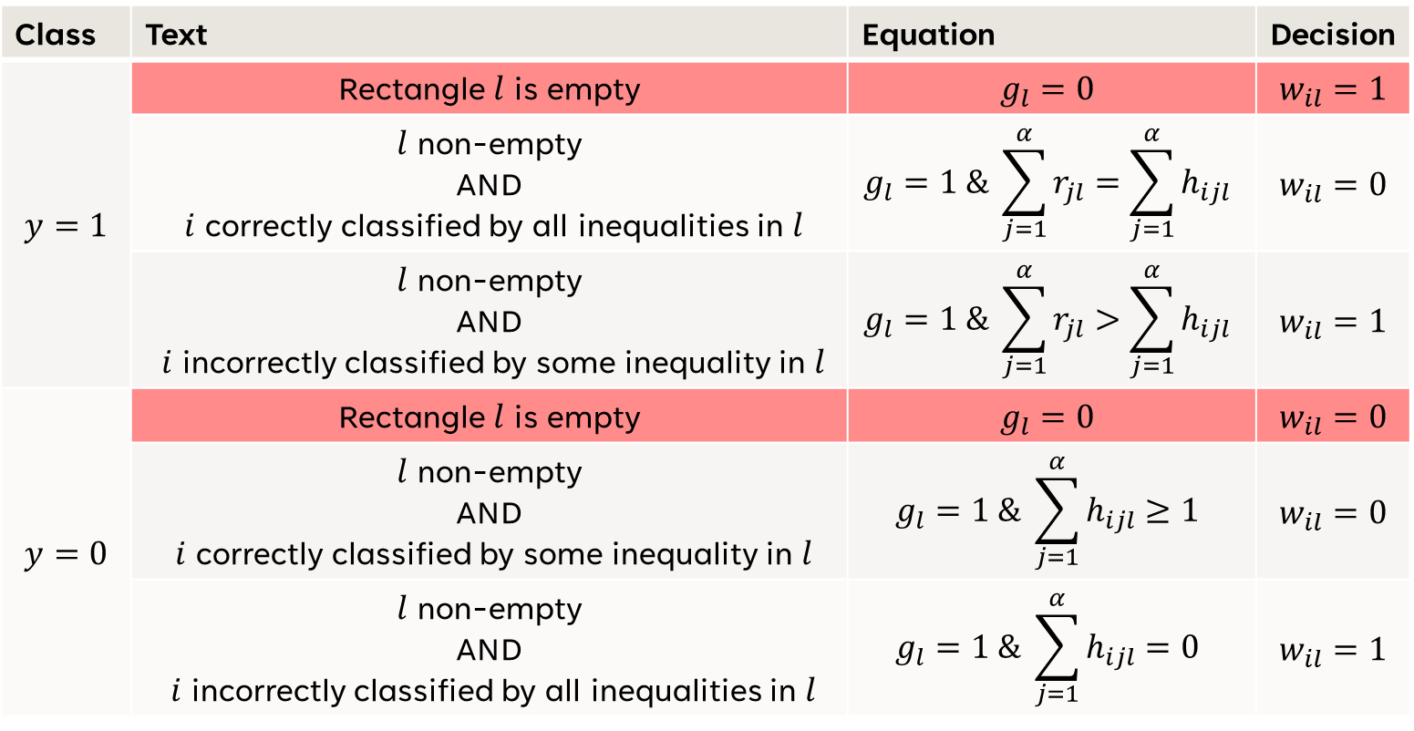
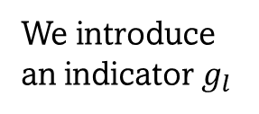
Encoding a rule set - Rectangles
Class | Text | Equation | Decision
$$y=1$$ | Rectangle $l$ is empty | $$g_{l}=0$$ | $$w_{il}=1$$
 | $l$ non-empty AND $i$ correctly classified by all inequalities in $l$ | $$g_{l}=1 \& \sum_{j=1}^{α}{r_{jl}}=\sum_{j=1}^{α}{h_{ijl}}$$ | $$w_{il}=0$$
 | $l$ non-empty AND $i$ incorrectly classified by some inequality in $l$ | $$g_{l}=1 \& \sum_{j=1}^{α}{r_{jl}}>\sum_{j=1}^{α}{h_{ijl}}$$ | $$w_{il}=1$$
$$y=0$$ | Rectangle $l$ is empty | $$g_{l}=0$$ | $$w_{il}=0$$
 | $l$ non-empty AND $i$ correctly classified by some inequality in $l$ | $$g_{l}=1 \& \sum_{j=1}^{α}{h_{ijl}≥1}$$ | $$w_{il}=0$$
 | $l$ non-empty AND $i$ incorrectly classified by all inequalities in $l$ | $$g_{l}=1 \& \sum_{j=1}^{α}{h_{ijl}=0}$$ | $$w_{il}=1$$
We introduce an indicator $g_{l}$
Department of Mathematics and Computer Science
Notes:
To fix this, we introduce indicator g, checking whether a rectangle is empty

Slide 30
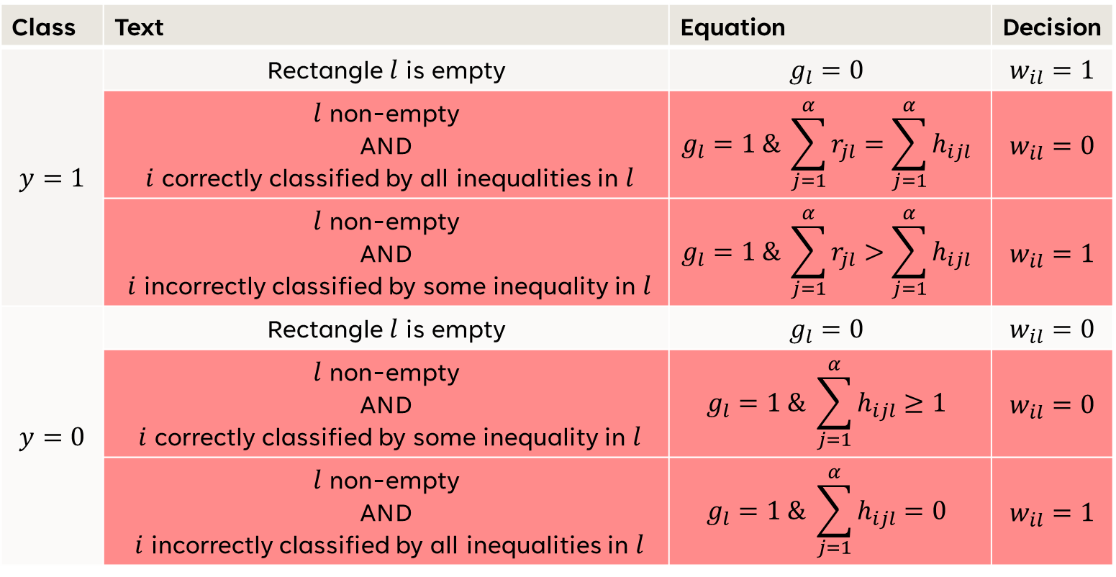
Encoding a rule set - Rectangles
Class | Text | Equation | Decision
$$y=1$$ | Rectangle $l$ is empty | $$g_{l}=0$$ | $$w_{il}=1$$
 | $l$ non-empty AND $i$ correctly classified by all inequalities in $l$ | $$g_{l}=1 \& \sum_{j=1}^{α}{r_{jl}}=\sum_{j=1}^{α}{h_{ijl}}$$ | $$w_{il}=0$$
 | $l$ non-empty AND $i$ incorrectly classified by some inequality in $l$ | $$g_{l}=1 \& \sum_{j=1}^{α}{r_{jl}}>\sum_{j=1}^{α}{h_{ijl}}$$ | $$w_{il}=1$$
$$y=0$$ | Rectangle $l$ is empty | $$g_{l}=0$$ | $$w_{il}=0$$
 | $l$ non-empty AND $i$ correctly classified by some inequality in $l$ | $$g_{l}=1 \& \sum_{j=1}^{α}{h_{ijl}≥1}$$ | $$w_{il}=0$$
 | $l$ non-empty AND $i$ incorrectly classified by all inequalities in $l$ | $$g_{l}=1 \& \sum_{j=1}^{α}{h_{ijl}=0}$$ | $$w_{il}=1$$
We introduce an indicator $g_{l}$
Department of Mathematics and Computer Science

Slide 31
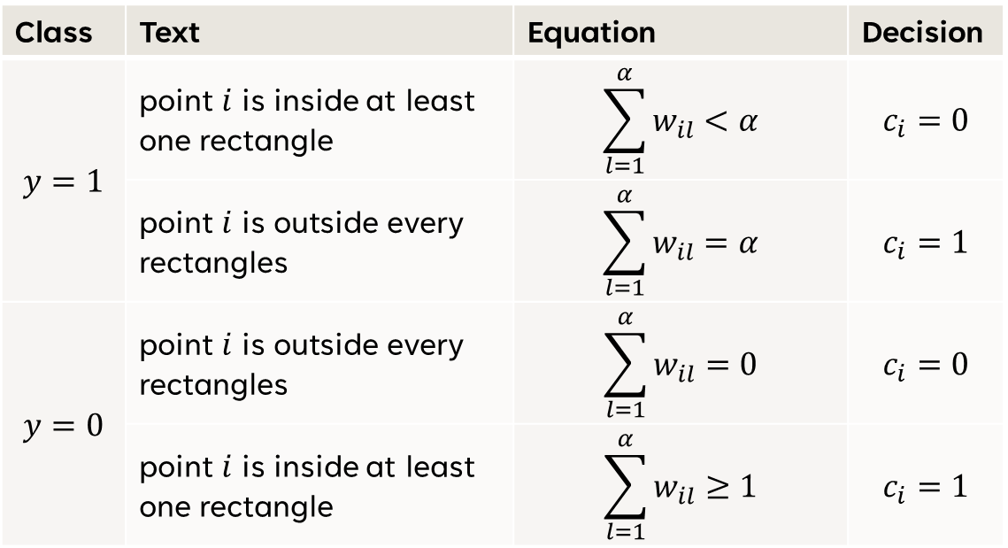
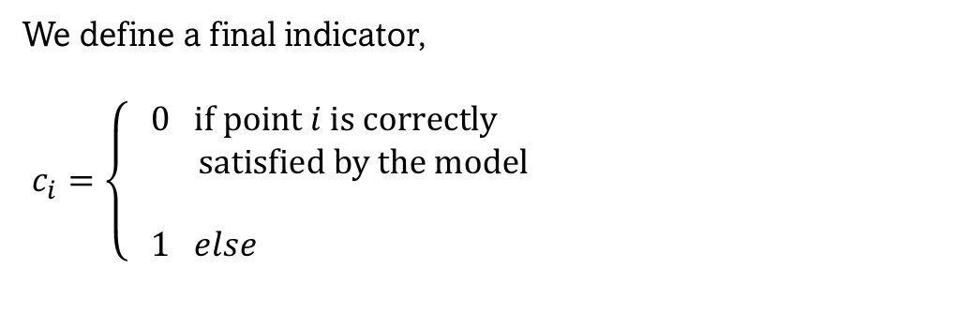
Encoding a rule set – Objective function
Class | Text | Equation | Decision
$$y=1$$ | point $i$ is inside at least one rectangle | $$\sum_{l=1}^{α}{w_{il}<α}$$ | $$c_{i}=0$$
 | point $i$ is outside every rectangles | $$\sum_{l=1}^{α}{w_{il}=α}$$ | $$c_{i}=1$$
$$y=0$$ | point $i$ is outside every rectangles | $$\sum_{l=1}^{α}{w_{il}=0}$$ | $$c_{i}=0$$
 | point $i$ is inside at least one rectangle | $$\sum_{l=1}^{α}{w_{il}≥1}$$ | $$c_{i}=1$$
We define a final indicator,
$c_{i}=\left\{\begin{aligned}0& if point i is correctly \\ satisfied by the model \\ \\ 1& else\end{aligned}\right.$
Department of Mathematics and Computer Science
Notes:
we have the tools to check …
we define indicator c, following this logic

Slide 32
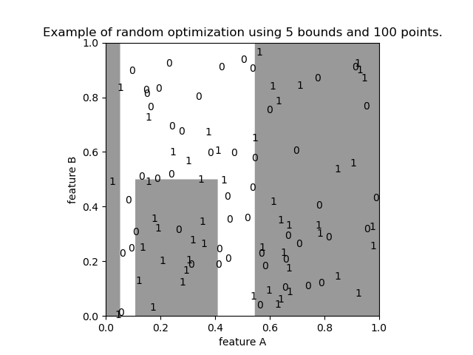
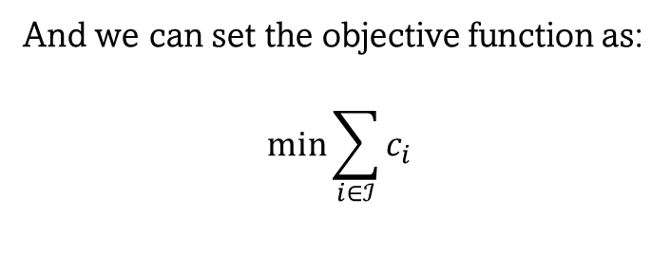
Encoding a rule set – Objective function
And we can set the objective function as:
$$\min{\sum_{i∈ℐ}^{ }{c_{i}}}$$
Department of Mathematics and Computer Science
Notes:
set the objective as minimizing sum.
example of a rule set found.
random data

Slide 33
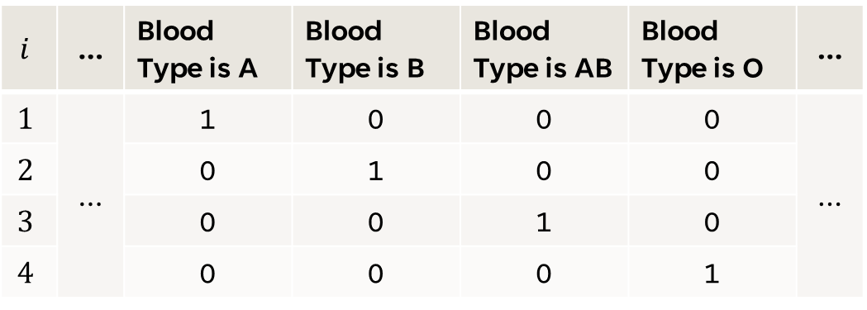
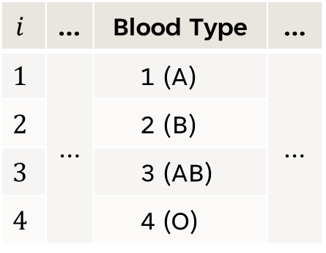
Data Treatment - Binarization
Sometimes we will encounter categorical features, which contain non-numeric data or where each value represents a different quality of the sample
Example: Blood type, Race or Sex
We binarize via one-hot scheme:
$$i$$ | … | Blood Type is A | Blood Type is B | Blood Type is AB | Blood Type is O | …
$$1$$ | … | 1 | 0 | 0 | 0 | …
$$2$$ |  | 0 | 1 | 0 | 0
$$3$$ |  | 0 | 0 | 1 | 0
$$4$$ |  | 0 | 0 | 0 | 1
$$i$$ | … | Blood Type | …
$$1$$ | … | 1 (A) | …
$$2$$ |  | 2 (B)
$$3$$ |  | 3 (AB)
$$4$$ |  | 4 (O)
Department of Mathematics and Computer Science
Notes:
categorical features for example ….,
order of their labels will influence the resulting rule sets.
For example if ‘type A’ is 1, we can select by ‘bloodType <=1’, but if it is 2 or 3, we need 2 inequalities to select it.
better to binarize as shown,
we create a new feature for every category

Slide 34
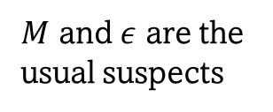
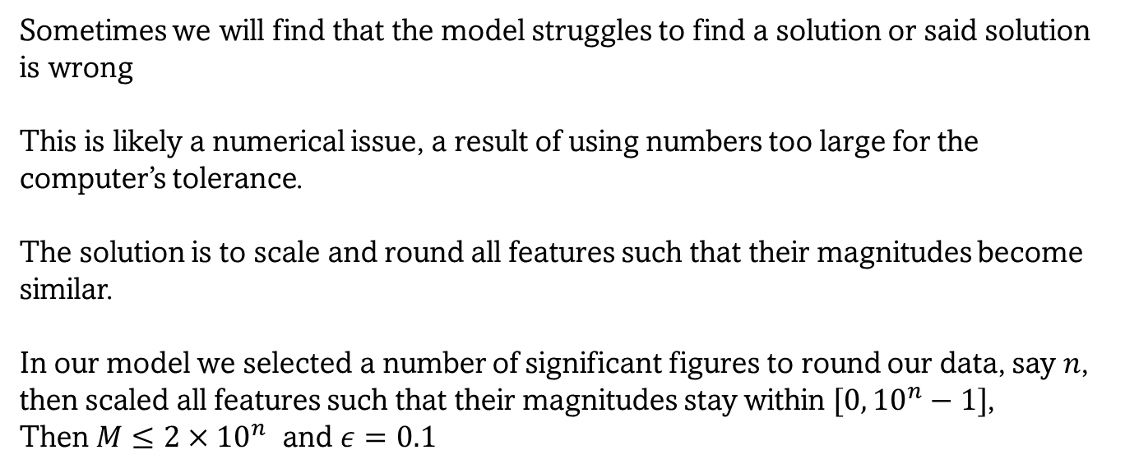
Data Treatment – Scaling & Rounding
Sometimes we will find that the model struggles to find a solution or said solution is wrong
This is likely a numerical issue, a result of using numbers too large for the computer’s tolerance.
The solution is to scale and round all features such that their magnitudes become similar.
In our model we selected a number of significant figures to round our data, say $n$, then scaled all features such that their magnitudes stay within $[0, {10}^{n}−1]$,
Then $M≤2×{10}^{n}$ and $ε=0.1$
$M$ and $ε$ are the usual suspects
Department of Mathematics and Computer Science
Notes:
Model struggles
likely numerical issue,
using too many significant figures
In our model, M and epsi are the usual suspects
Solution to round our data to a reasonable number of SFs,
and scale features such that values occupy similar ranges.
In our model we …

Slide 35
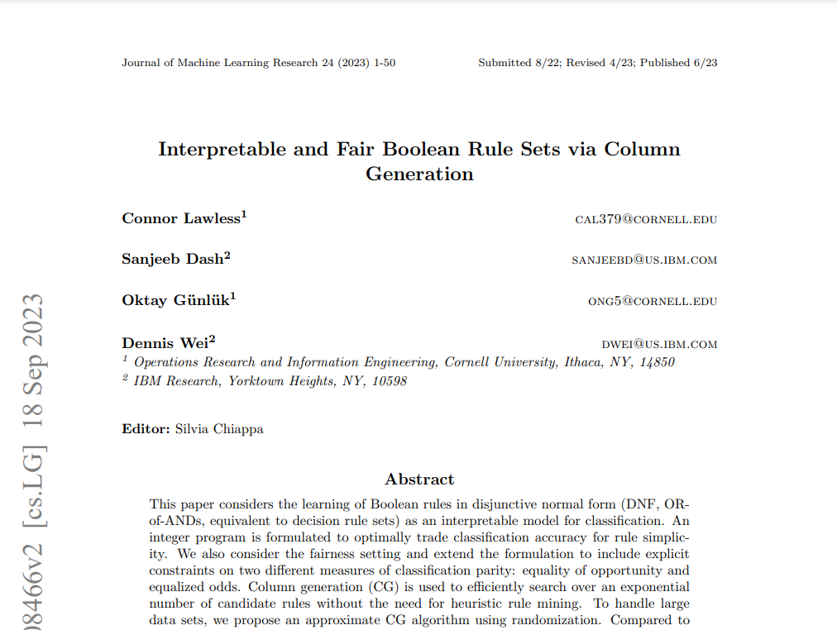
Solutions in literature
The interpretable model (and fairness constraints) are inspired on the work by Lawless et al. 2023.
Department of Mathematics and Computer Science
Notes:
This interpretable model is inspired on the work by Lawless ,
with some key differences

Slide 36
Solutions in literature
The interpretable model (and fairness constraints) are inspired on the work by Lawless et al. 2023.
However, there are key differences:
They binarize every feature.
Their model grows exponentially with the number of features (in constraints and variables)
They use column generation and heuristics
Instead of 0-1 loss, they minimize hamming loss
(points can be miss-classified many times)
And use heuristics for larger datasets
Department of Mathematics and Computer Science
Notes:
They use Boolean rule sets, so they binarize every feature,
Thus, their rules are not encoded using rectangles, but with …
simpler to encode,
but it grows exponentially by 2^n
In both constrs and vars
they use a column generation algo,
they minimize hamming loss, not 0-1, and
use different heuristics for large datasets

Slide 37
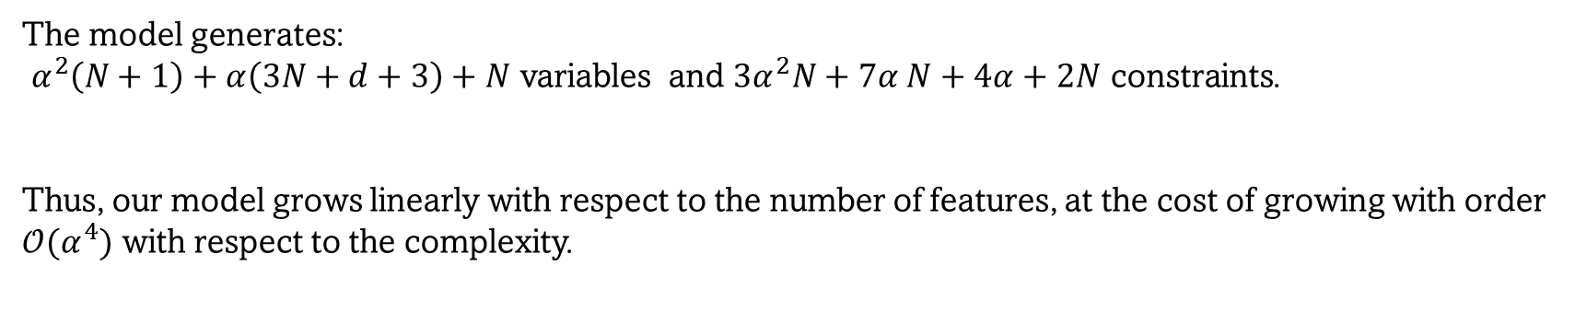
Base Model Performance
The model generates:
$α^{2}\left(N+1\right)+α\left(3N+d+3\right)+N$ variables and $3α^{2}N+7α N+4α+2N$ constraints.
Thus, our model grows linearly with respect to the number of features, at the cost of growing with order $𝒪(α^{4})$ with respect to the complexity.
Department of Mathematics and Computer Science
Notes:
model generates *this many* variables
and *this many* constraints
note ours grows linearly with features, and
only in variables,
At the cost of growing in terms of the complexity by alpha^4

Slide 38
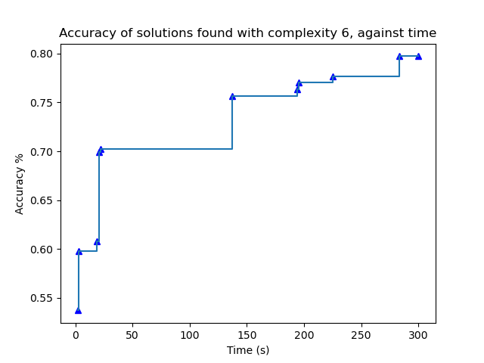
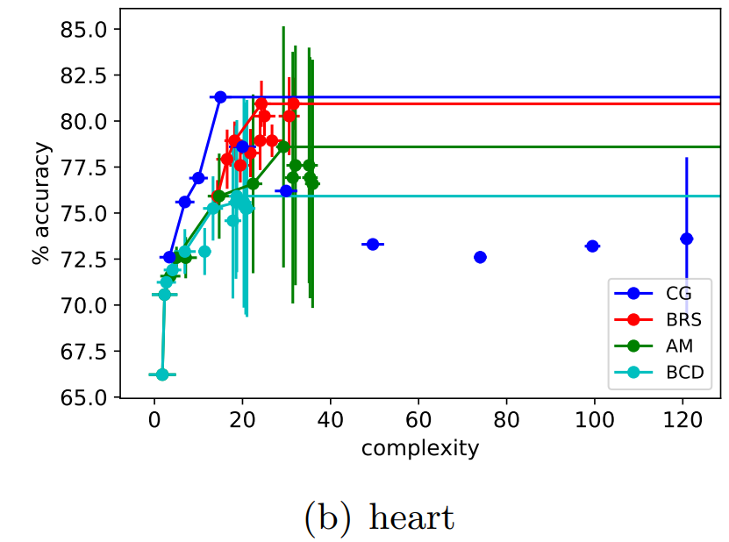
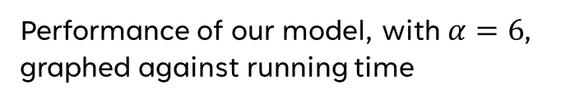
Base Model Performance – Heart Disease
Performance of column generation model (CG) and other methods, with a time limit of 5 minutes. Graphed against complexity.
Performance of our model, with $α=6$, graphed against running time
79.92%
(299x137)
(296x22)
Department of Mathematics and Computer Science
Notes:
How does the model perform?
we take results from their paper,
they run their CG algo along with other models
time limit of 5 mins.
we compare on small dataset and
low complexity,
our model seems to outperform the literature.

Slide 39
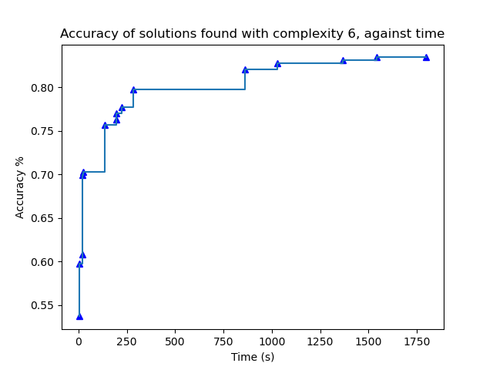
Base Model Performance – Heart Disease
Performance of column generation model (CG) and other methods, with a time limit of 5 minutes. Graphed against complexity.
Performance of our model, with $α=6$, graphed against running time
83.44%
(299x137)
(296x22)
Department of Mathematics and Computer Science
Notes:
And if we keep it running, by the 15 minute mark we have already found a better rule set.

Slide 40
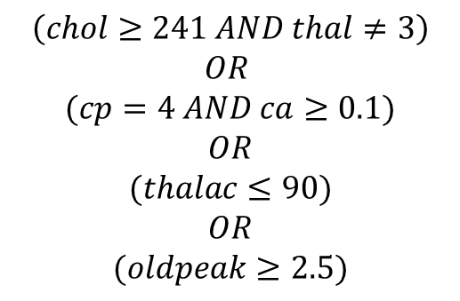
Base Model Performance – Heart Disease
After 2 hours …
85.81%
$$\left(chol≥241 AND thal≠3\right)$$
$$OR$$
$$(cp=4 AND ca≥0.1)$$
$$OR$$
$$(thalac≤90)$$
$$OR$$
$$(oldpeak≥2.5)$$
chol: Cholesterol (mg/dl)
thal: Type of defect
cp: Chest pain type
ca: Number of major vessels colored in fluoroscopy
thalach: Max heart rate
oldpeak: ST depression induced by exercise
Department of Mathematics and Computer Science
Notes:
And in 2 hours we found a rule set with 85% accuracy

Slide 41
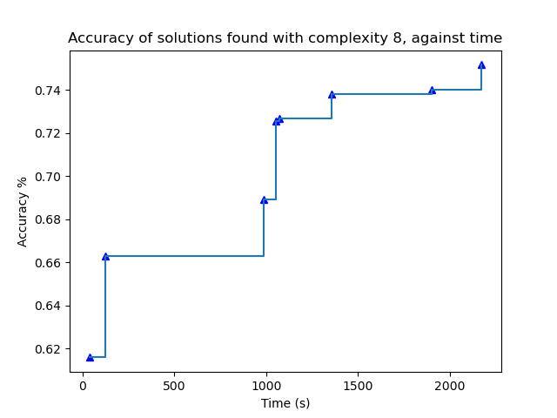
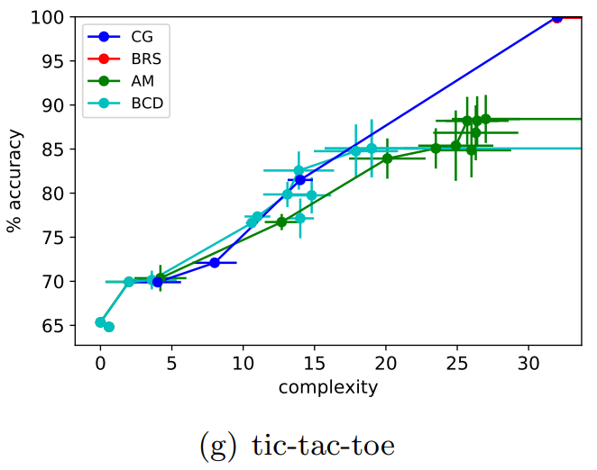
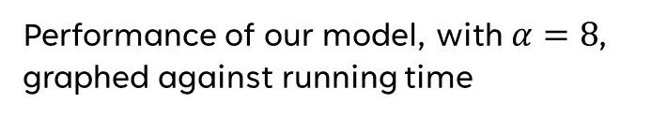
Base Model Performance – Tic-Tac-Toe
Performance of column generation model (CG) and other methods, with a time limit of 5 minutes. Graphed against complexity.
Performance of our model, with $α=8$, graphed against running time
(958x55)
(958x27)
Department of Mathematics and Computer Science
Notes:
larger dataset, where most features are categorical
*explain dataset*
our model doesn’t perform as well.
slightly under 15 mins to match their results
And it needs 36 minutes to find a better ruleset than the other methods

Slide 42
adding cost-sensitivity

Slide 43
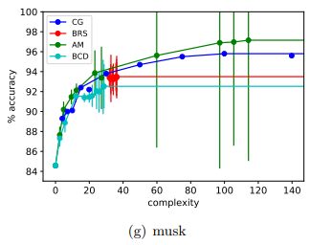

The Reality of Costs
Increasing the complexity of the model allows it to choose more rules and therefore be more accurate.
For a real-world application, such as diagnosis, this is not a good idea, as tests cost money.
We need to count the cost of the features selected in a rule set and limit it with a budget
Department of Mathematics and Computer Science
Notes:
higher complexity = higher accuracy.
involves more tests, very expensive.
not blindly trust accuracy past a certain point,
as it is possible this might be the result of data overfitting
This reinforces our decision to limit complexity to a low value, but
even rule set size 10 can go over budget
we limit the cost of features with budget

Slide 44

Encoding costs – Simple Case
We will consider 2 cases.
The simple case assigns a cost $π_{k}∈ℝ$ to every feature $k∈ℱ,$
and constrains the cost of all selected features to be less than a budget $β∈ℝ$
To know if a feature is selected, it is not enough to use $a_{jk}$, as a rule set might choose the same feature more than once. We define a binary indicator,
$q_{k}=\left\{\begin{aligned}1& if a_{jk}=1 for at least one j \\ 0& else\end{aligned}\right.$
Then we can constrain the model by adding:
$$\sum_{k∈ℱ}^{ }{q_{k}π_{k}}≤β$$
Department of Mathematics and Computer Science
Notes:
2 cases
simple case, a cost to every feature.
can have many of the same,
so we need a new one
q=1 when at least one a=1
we constrain by adding this inequality to the model

Slide 45


Encoding costs – Discounted Case
In the discounted case we realize that some features (tests) are related.
If one of them is performed, it might make the rest cheaper.
We define feature subsets $ℱ_{n}⊂ℱ$, $n=1,…,η$,
where each set has a shared cost $τ_{n}∈ℝ$, and each feature has an individual cost $π_{k}^{′}∈ℝ$
Then, using $q_{k}$, we can define an indicator for having selected any of the features in a subset:
$p_{n}=\left\{\begin{aligned}1& if q_{k}=1 for at least one k∈ℱ_{n} \\ 0& else\end{aligned}\right.$
Then we can constrain the model by adding:
$$\sum_{k∈ℱ}^{ }{q_{k}{π′}_{k}}+ \sum_{n=1}^{η}{p_{n}τ_{n}}≤β$$
Department of Mathematics and Computer Science
Notes:
discounted case,
cost of some tests are related.
For instance, an electrocardiogram might be very expensive, but it gives you a lot of information that is reflected among many features
(slope, peak, etc..) So it is fair to assume that, once we do a test once for a feature, we do not have to pay full price again If we include a related feature in the data set
We def feature subsets…

Slide 46

Solutions in literature
These cost-sensitivity constraints and cases are inspired on the work by Abdulla and Khasawneh 2022
Department of Mathematics and Computer Science
Notes:
these 2 cases inspired by work
in this paper by Abdulla and Khasawneh

Slide 47
Solutions in literature
These cost-sensitivity constraints and cases are inspired on the work by Abdulla and Khasawneh 2022
They use SVMs, which are incompatible with our interpretability constraint
Department of Mathematics and Computer Science
Notes:
they use SVM,
incompatible with interpretability

Slide 48
Base Model Performance – Heart Disease
Using their data …
Individual
Costs (€)
Feature sets
age: Age
sex: Male/Female
cp: Chest pain type
trestbps: Resting blood pressure
chol: Cholesterol (mg/dl)
fbs: Fasting blood sugar
restecg: Resting electrocardiographic results
thalach: Max heart rate
thal: Type of defect
exange: Exercise induced angina
oldpeak: ST depression induced by exercise
slope: Slope of peak ST segment
ca: Number of major vessels colored in fluoroscopy
1,00
1,00
1,00
1,00
7,20
5,20
15,50
102,90
102,90
87,30
87,30
87,30
100,90
-
-
-
-
AA-
B
BCCC-
A: -2,1
B: -101,9
C: -86,3
Department of Mathematics and Computer Science
Notes:
they use the same dataset,
*here is description of featues*
we use same feature costs and subsets

Slide 49
Base Model Performance – Heart Disease
Using their data …
85.81%
Simple
Discounted
$$\left(chol≥241 AND thal≠3\right)$$
$$OR$$
$$(cp=4 AND ca≥0.1)$$
$$OR$$
$$(thalac≤90)$$
$$OR$$
$$(oldpeak≥2.5)$$
chol: 7,2€
thal: 102,9€
cp: 1€ (0)
ca: 100,9€
thalach: 102,9€
oldpeak: 87,3€
---------------------
402,2€
chol: 7,2€
thal: 102,9€
cp: 1€ (0)
ca: 100,9€
thalach: 1€ (-101,9€)
oldpeak: 87,3€
---------------------
300,3€
Department of Mathematics and Computer Science
Notes:
previous rule set has cost of
400 in simple
300 in discounted

Slide 50


Base Model Performance – Heart Disease
Simple
Discounted
$$((thalach≤ 150.0) AND (Is thal≠ 3))$$
$$OR$$
$$((oldpeak≥ 2.41))$$
$$OR$$
$$((cp = 4) AND (thalach≤ 177.0))$$
$$(cp = 4) AND (thal≠ 3))$$
$$OR$$
$$((oldpeak≥ 2.50) AND (Is slope≠ 3))$$
$$OR$$
$$((thalach≤ 112.0))$$
Accuracy: 81.4% 82.4%
Cost: 294,1€ 193.2€
Department of Mathematics and Computer Science
Notes:
lower budget,
found 2 rule sets:
*Note cost, Acc and Size of right*

Slide 51

Base Model Performance – Heart Disease
Department of Mathematics and Computer Science
Notes:
compare against literature,
here are results in their paper.
5 models compared against a SVM control
CSs are their models, other 3 are other methods
Note CSs are both discounted
our model reaches the same accuracy,
with 100 lower cost
and one less feature

Slide 52
adding fairness

Slide 53


Controlling for fairness
Rule sets are affordable and interpretable, but are they fair?
Given a feature (such as sex or race), is the probability of being miss-classified independent of the value of said feature?.
How do we know and how do we correct this?
We use 2 metrics explored by Hardt et al. 2016:
M. Hardt et al. Equality of opportunity in supervised learning. Advances in Neural Information Processing Systems, volume 29. Curran Associates, 2016.
Department of Mathematics and Computer Science
Notes:
in a real world scenario,
need the model to be interpretable and affordable,
also fair
we define as , given a sensitive feature (such as..)
is the probab. Is missclassi Independent?
Use 2 metrics

Slide 54

Fairness – Equal opportunity
Let $G⊂ℱ$, be the group of protected features.
Let $Im\left(k\right)≔\{ f : ∃_{\left\{i∈ℐ\right\}} x_{ik}=f\}$ for $k∈G$
Equal opportunity demands that the false negative rate be equal within $k:$
For $k∈G$ and every pair $f_{1},f_{2}∈Im(k)$:
$$ℙ\left(c_{i}=1\right|i∈𝒫, x_{ik}=f_{1})=ℙ\left(c_{i}=1 \right|i∈𝒫, x_{ik}=f_{2})$$
Department of Mathematics and Computer Science
Notes:
In the first one
equal opportunity
We let G be a …
We want FN rate equal within k
So, for k and pair of values
We need to satisfy this condition

Slide 55


Fairness – Equal opportunity
Let $G⊂ℱ$, be the group of protected features.
Let $Im\left(k\right)≔\{ f : ∃_{\left\{i∈ℐ\right\}} x_{ik}=f\}$ for $k∈G$
Equal opportunity demands that the false negative rate be equal within $k$
For $k∈G$ and every pair $f_{1},f_{2}∈Im(k)$:
$$ℙ\left(c_{i}=1\right|i∈𝒫, x_{ik}=f_{1})≈ℙ\left(c_{i}=1 \right|i∈𝒫, x_{ik}=f_{2})$$
We can constrain the model with:
$$\left| \frac{\sum_{i∈𝒫_{k}^{f_{1}}}{c_{i}}}{\left|𝒫_{k}^{f_{1}}\right|} − \frac{\sum_{i∈𝒫_{k}^{f_{2}}}{c_{i}}}{\left|𝒫_{k}^{f_{2}}\right|} \right|≤ε (=0.05)$$
$𝒫_{k}^{f_{1}}$ is the set of samples in $𝒫$where $x_{ik}=f_{1}$
Department of Mathematics and Computer Science
Notes:
not guaranteed to find a feasible rule set
if enforce this exactly,
instead constrain their difference
with bound, set at 5%

Slide 56

Fairness – Equal odds
Let $G⊂ℱ$, be the group of protected features.
Let $Im\left(k\right)≔\{ f : ∃_{\left\{i∈ℐ\right\}} x_{ik}=f\}$ for $k∈G$
Equal odds demands that both the false negative and false positive rate be equal within $k$
$$ℙ\left(c_{i}=1 \right|i∈𝒫, x_{ik}=f_{1})=ℙ\left(c_{i}=1 \right|i∈𝒫, x_{ik}=f_{2})$$
And
$$ℙ\left(c_{i}=1 \right|i∈𝒩, x_{ik}=f_{1})=ℙ\left(c_{i}=1 \right|i∈𝒩, x_{ik}=f_{2})$$
Which we can constrain similarly
Department of Mathematics and Computer Science
Notes:
In the second metric,
both the FP and FN rates to be equal
Constrain similarly

Slide 57

Rule set fairness – Heart Disease
 | Base | Eq. Opportunity | Eq. Odds
Accuracy | 85.5 %
Max. fairness violation (FN) | 25.3 %
Men | 10.7 %
women | 36.0 %
Max. fairness violation (FP) | 24.7 %
Men | 24.7 %
women | 0.0 %
$$(sex = 1) AND (ca≥ 0.1)$$
$$OR$$
$$(ca≥ 2.1)$$
$$OR$$
$$(oldpeak≥ 0.80) AND (thal = 7)$$
$$OR$$
$$(oldpeak≥ 2.61)$$
Department of Mathematics and Computer Science
Notes:
go back to this rule set,
patient’s sex to be a protected feature,
*describe table*
acc of 85%, but
women 3 times as likely to FN
men only ones being FP

Slide 58

Rule set fairness – Heart Disease
Equal opportunity
 | Base | Eq. Opportunity | Eq. Odds
Accuracy | 85.5 % | 83.1 %
Max. fairness violation (FN) | 25.3 % | 2.6 %
Men | 10.7 % | 13.4 %
women | 36.0 % | 16.0 %
Max. fairness violation (FP) | 24.7 % | 19.5 %
Men | 24.7 % | 28.1 %
women | 0.0 % | 8.5 %
$$(ca≥1.1)$$
$$OR$$
$$\left(\left( thal = 7\right) AND \left(trestbps≥ 108.1\right)\right)$$
$$OR$$
$$(\left(exang≠ 0\right) AND \left(thalach≤144.0\right) AND (cp = 4))$$
Department of Mathematics and Computer Science
Notes:
If equal opportunity,
accuracy has decreased to 83%
FN rate has decreased to 2%.
became more accurate for women but worse for men,
in FP, it became worse for both
fair ruleset =!= an acc ruleset,
*coin analogy*
in this case, a FN is more dangerous than a FP,
so this the loss in acc is wort it

Slide 59

Rule set fairness – Heart Disease
Equalized odds
 | Base | Eq. Opportunity | Eq. Odds
Accuracy | 85.5 % | 83.1 % | 84.1 %
Max. fairness violation (FN) | 25.3 % | 2.6 % | 4.11 %
Men | 10.7 % | 13.4 % | 24.1 %
women | 36.0 % | 16.0 % | 20.0 %
Max. fairness violation (FP) | 24.7 % | 19.5 % | 4.09 %
Men | 24.7 % | 28.1 % | 11.2 %
women | 0.0 % | 8.5 % | 7.1 %
$$(ca≥ 0.1) AND (trestbps≥ 118.1) AND (thal≠ 3)$$
$$OR$$
$$(oldpeak≥ 2.41)$$
$$OR$$
$$(exang≠ 0) AND (cp = 4)$$
Department of Mathematics and Computer Science
Notes:
if we enforce equalized odds,
we see both rates are within 4%
acc has increased,
this is not true in general.
Not the global optimum,
but best found within time limit.
solver uses some heuristics
there is randomness with how fast
we find quality solutions

Slide 60
Generalizing to more classes

Slide 61


More than 2 decisions
In some situations, a Yes-or-No decision is not informative enough.
We want to classify many types of labels
For example, when diagnosing cancer, we wish to know its stage if the model determines a sample should receive a positive diagnosis.
Department of Mathematics and Computer Science
Notes:
we want a model to classify
more than 2 classes,
for example *cancer*

Slide 62

Multiple classes
We have $𝒩$ as before, $𝒫_{ν}≔\{i∈𝒫:y_{i}=ν, ν>0\}$ and
$$𝒫≔ \bigcup_{ν=1}^{Υ}{𝒫_{ν}}$$
Then, each rule will have a class $ν$, determined by indicator $γ_{lν}$:
$$γ_{lν}=\left\{\begin{aligned}1& if rectangle l is of class ν \\ 0& else\end{aligned}\right.$$
Department of Mathematics and Computer Science
Notes:
define multiple positive classes,
depending on their lable.
need to assign a class to each rule,
using indicator gamma

Slide 63

Multiple classes
The constraints for points $i∈𝒩$ can remain the same
For $i∈𝒫$, we need to know if they are
inside at least one rectangle of their class
and outside all rectangles of other classes
We implement using 3 additional indicator variables
Department of Mathematics and Computer Science
Notes:
points in N, doesn’t change
need to be outside all rectangles, regardless of class
positive points,
need to know if *…*
For the sake of time, we will not go over them
But we will show an example

Slide 64

Generalization Performance – Heart Disease
$$\left(y=1\right): (trestbps>=180.1) OR (thalach<=109.0)$$
$$\left(y=2\right): \left(oldpeak >=2.80\right) OR (thalach<=71.0)$$
$$\left(y=3\right): (chol<=183.0) AND (thalach<=120.0)$$
$$\left(y=4\right): (age>=76.1)$$
Accuracy: 59.4%
after 30 minutes
Department of Mathematics and Computer Science
Notes:
heart disease dataset
using original labels, from 0 to 4,
for the severity of the diagnosis.
for this many classes,
need increase the complexity
to obtain good results

Slide 65


Generalization Performance
Department of Mathematics and Computer Science
Notes:
2 additional examples
randomly generated 2-dim data

Slide 66
Conclusion

Slide 67
Contribution
Our model can generate accurate, interpretable, fair and affordable rule sets that can compete against the literature in terms of quality
There is indication it outperforms the literature for small datasets with non-categorical features.
However, the performance of the model for large datasets and datasets with many categorical features is lacking
Department of Mathematics and Computer Science
Notes:
Generate Accurate
Interpretable, fair and affordable
Competes with small datasets
Fails with large datsets

Slide 68
Further steps
Improve rule set encoding and optimizing the size of the model
Analyzing the effects of different data treatments such as a complete binarization of the dataset, different rounding tolerances, etc…
Further testing on applications of the model using more diverse data sets
Department of Mathematics and Computer Science
Notes:
Improve model
See how data affects model
Test more applications

Slide 69
Department of Mathematics and Computer Science

Slide 70

Appendix A – Full Model

Slide 71



Slide 72



Slide 73



Slide 74



Slide 75





